Slide 1

Zühlke Tech 4 Good: Kickoff Sprint
Tech Returners, Team CodeBenders
March’21 Cohort
Ciaran Cullen, Marius Grigore, Susan Luebke, Sriranjini Srinivasa
March 18, 2021

Slide 2

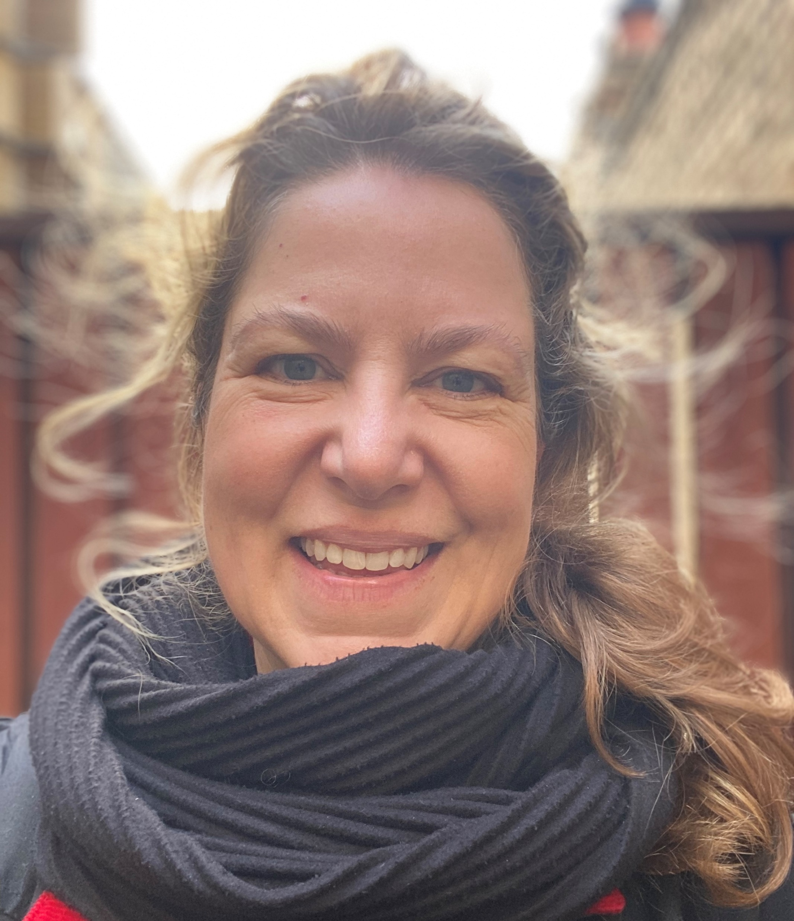
Susan Luebke Hello – my name is Susan. I have an MSW, MBA and 15 years’ experience as an innovative consumer Insights and brand marketing professional with project, agency and stakeholder management expertise with LG, Bacardi, Grace Kennedy, BP and LucasArts, to name a few Experience with Python, SQL, PowerBI, Tableau, Google Analytics; and received awards for product design COVID-19 provided me with an opportunity to upskill and pursue a career switch with a greater emphasis on solution-based programming; something I’ve been interested in doing since writing my first iPhone app several years ago

Slide 3
Introduction & Processes
Team CodeBenders
Scrum for Agile Teams
Rotate Scrum Master weekly for Planning and Sprints
2x weekly Stand Ups
Exploit on our individual strengths
While upskilling each other with Pair and Mob Programming
15min Retrospective every Friday
Google Calendar for real-time availability
Miro Dashboards for collectively organizing meeting notes, requirements, processes

Slide 4
Sunny Walk*
Tech 4 Good

Slide 5
Create a web app that can advise the user on what the best times for them to take daily walks would be in order to maximise their intake of sunshine.
Persona – resident of Manchester/London or “walker”
FEATURES | STRETCH FEATURES | STRETCH FEATURES: DIFFERENT TYPES OF USERS | TECHNICAL
During what times I can get the most sunshine based on my location, current time and the weather forecast so I that I can plan my walk into my day and optimize my sunshine intake | Log the area where I walked so that I can track my walks on the map | Walker, customize my user profile so that I can receive relevant advice about/during my walks (e.g. I don’t like rain, so I would like to be advised if I should take an umbrella with me) | Responsive web design
Receive a notification some time before my walk so that I don’t miss it | My preferred locations so that I can plan to enjoy the sunshine in places that I usually frequent or I am about to travel to | Wheelchair user, I want to know about the walks that are accessible (wheelchair friendly) so that I can enjoy the sunshine without worries or assistance | Progressive web app
Log if a walk was good or bad so that I can track my satisfaction with the walks over time | Set up my preferred weather conditions so that I can enjoy my favourite weather during my walks. (e.g. I prefer cloudy weather; I prefer taking walks in the rain) | Dog walker, I want to know routes with dog-friendly areas nearby so that my dog can socialise with other dogs | Accessibility considerations
 |  | Parent, I want to know about routes that have parks with playgrounds nearby so that I can enjoy a walk without my children getting bored. | Possibility of using data from gov.uk (or something else), being Manchester
 |  | Roller skater, I want to know where the safest routes for roller skating are so that I can enjoy my hobby without needing replacement wheels after every outing or injuring myself
 |  | Walker, I want to leave comments about the area where I had a walk so that I can make other users aware about different area features. (e.g. water fountains, dog waste bins, etc.)

Slide 6
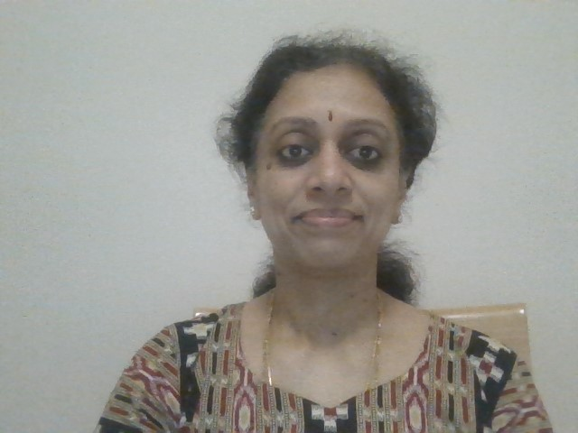
Sriranjini Srinivasa Masters Degree in Computer Applications Around 7 years of work experience as a Techno-Functional Consultant for ERP and RDBMS Fair knowledge of Asp.Net, C#, Java Worked with clients like Woolworths, Acer, Eaton Always open to learn new technologies

Slide 7
Mind Mapping with Miro
Miro to visualize our ideas
Mind mapping thoughts about development and possible features
Inclusivity design considerations: iconography, user interface, etc.
Accessibility considerations for various kinds of walkers
Examples of existing competitor apps for comparison and learnings

Slide 8
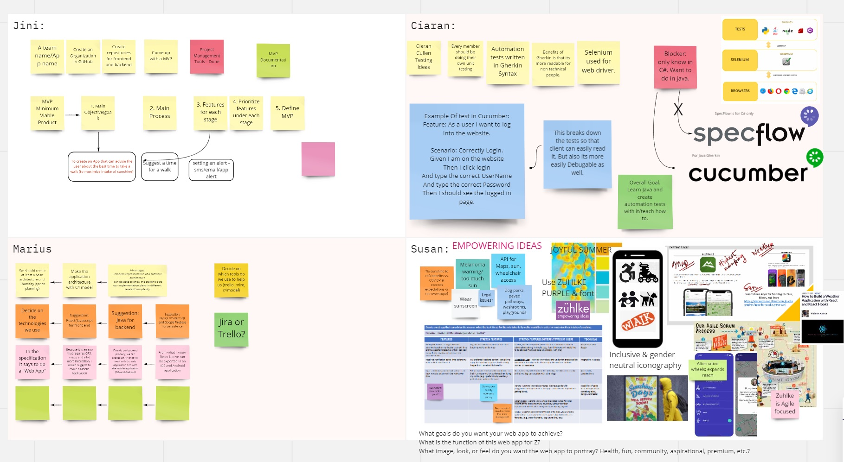

Slide 9
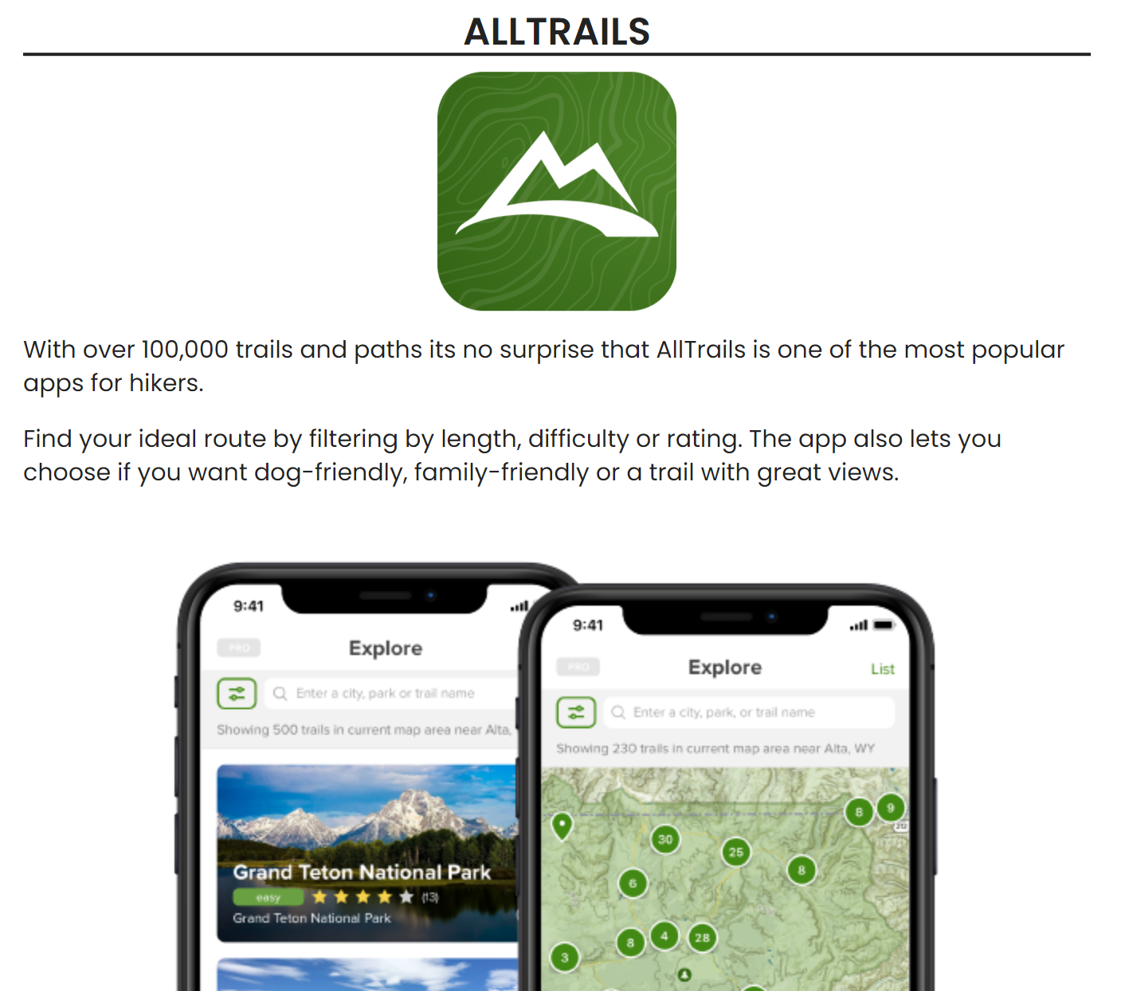
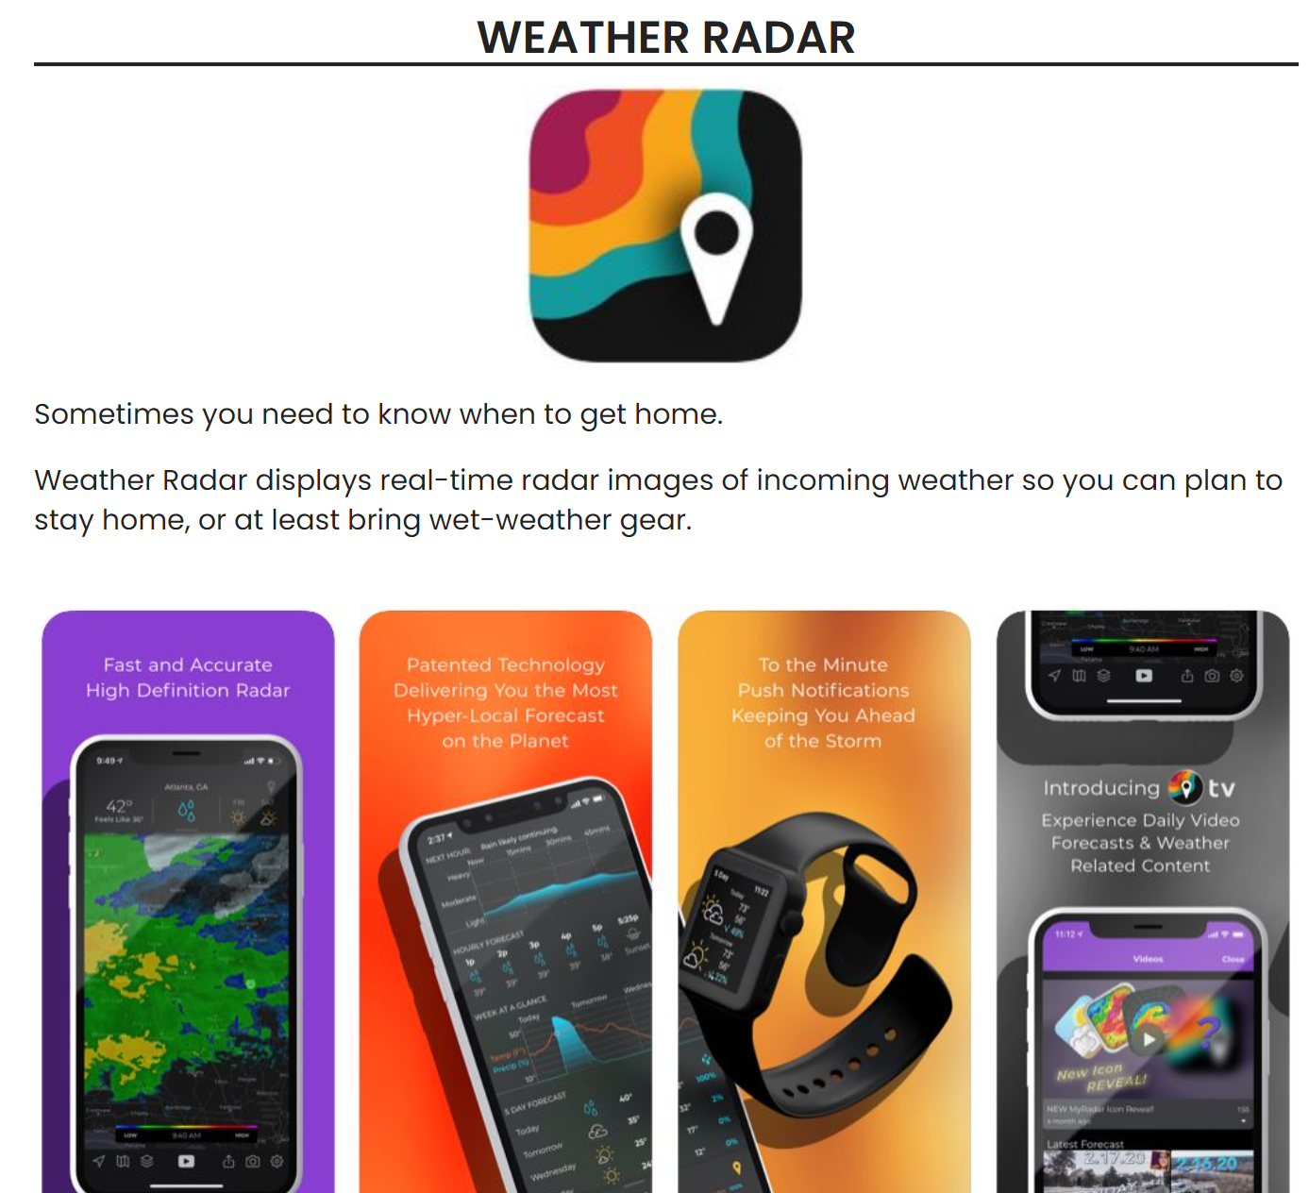









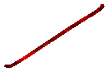












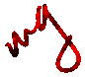
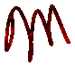
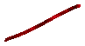

EXISTING TOOLS:
Smartphone Apps for Tracking the Sun, Moon, and Stars
https://havecamerawilltravel.com/photographer/apps-for-tracking-the-sun/

Slide 10
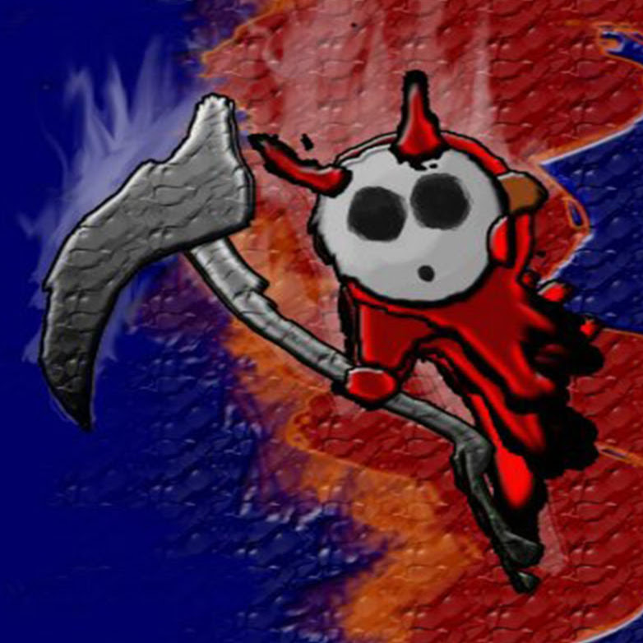
Ciaran Cullen Previous experience: 2 year accelerated BSc Games Programming course, 8 weeks of C#sdet training and a little work experience in a Telemarketer company Previous Projects: LDAP server syncing, Text based, 2D, 3D and VR games, Testing OpenWeatherMapAPI, Testing websites Tools/Libarys learned: for C++: SDL, SDL_net and Opengl using visual studio 2017 For C#: Unity, Nunit, SpecFlow and Selenium I have done very small projects using ASP.net, XAML and SQL servers. Self learning: Appium (mobile testing) Learning from Tec Returners: Java and JavaScript and much more!

Slide 11
Minimum Viable Product (MVP)
Received informative brief regarding features needed
First 3 features are part of the MVP
User input
Notification system
Feedback if walk was good or not

Slide 12
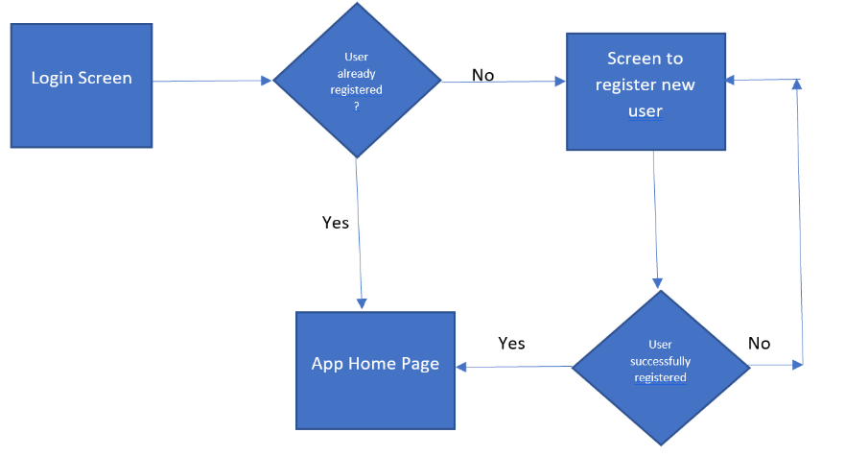
Wireframing – First Drafts
INITIAL STEPS:

Slide 13
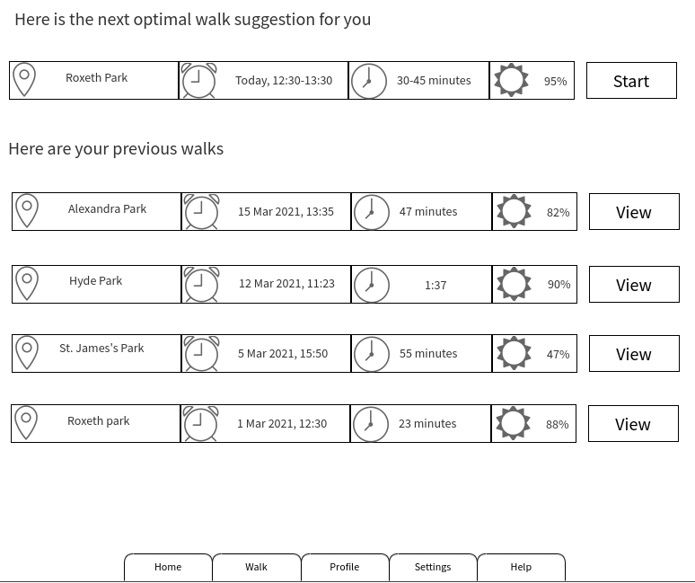
Wireframing – First Drafts
USER SCREEN: best times for a daily walk to maximise intake of sunshine

Slide 14
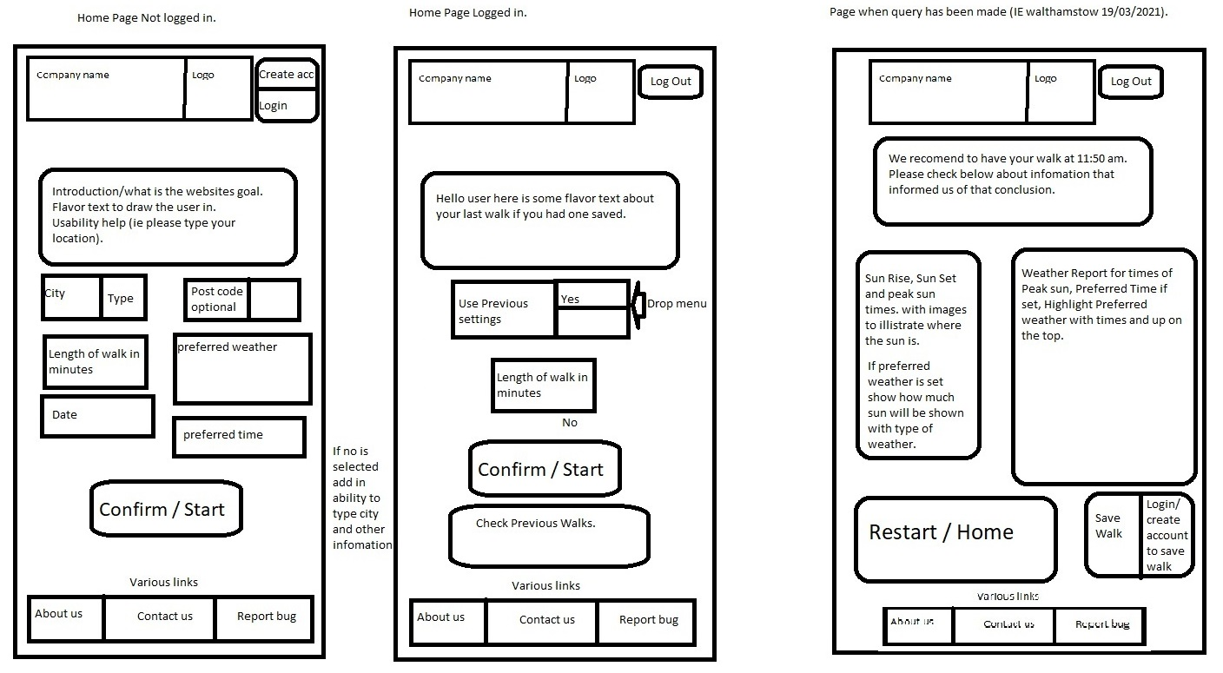
Wireframing – First Drafts
USER SCREENS: LOG IN, HOME PAGE, STRETCH FEATURES, ETC.

Slide 15
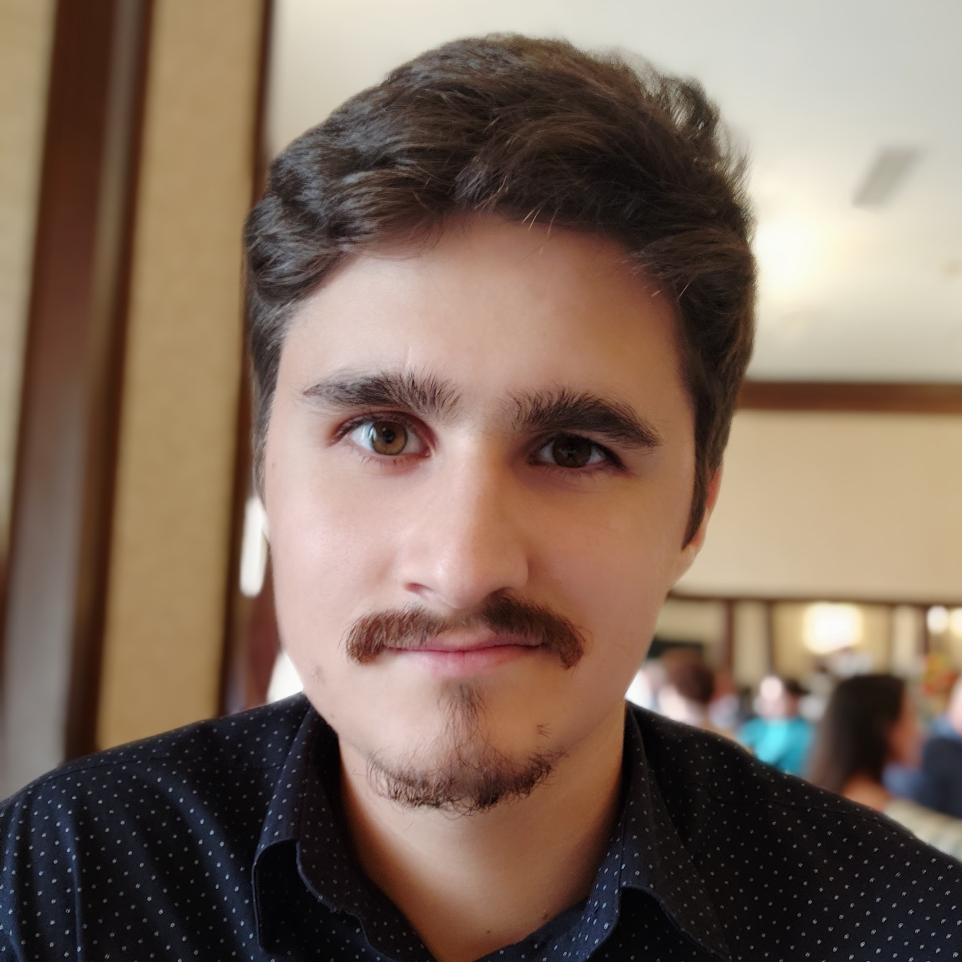
Marius Grigore BSc in Computer Science 4 years of commercial technical experience - Created internal automation tools (Python, Java, Matlab, VB) - Offered technical and process support for a team of 20 people - Worked on engine control projects for Renault and Nissan I have a real interest in everything related to technology

Slide 16











Tech Stack and Tools
Tech stack | Tools

Slide 17
Discussion
Thank you

